Slide 1
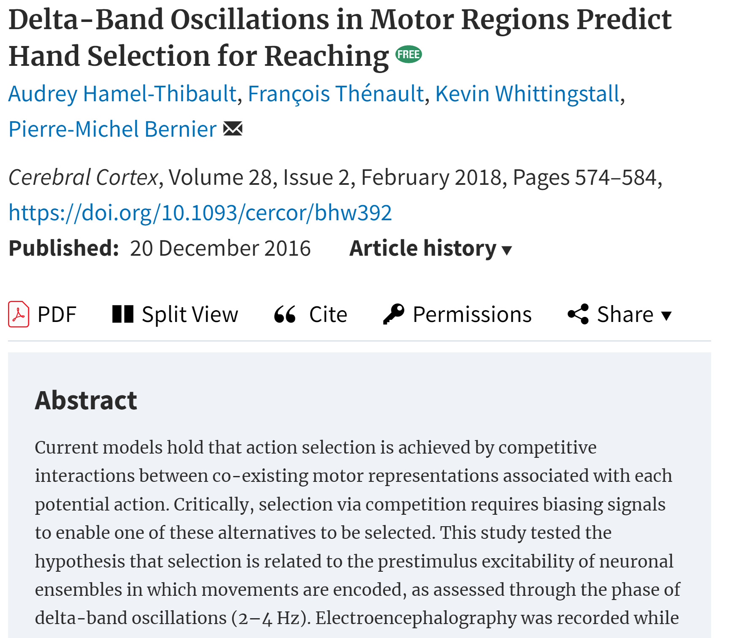
delta-band oscillations (2–4Hz) in motor regions predict hand choice
Hand selection and RT were influenced by the phase of delta oscillations at target onset
brain excitability modulates action selection ,independent of other decision factors.
*(other paper) not symmetric
Notes:
这篇文章研究了运动区域的Delta波段振荡如何预测手部选择。在实验中，参与者需要选择使用左手或右手来快速伸手触及出现的视觉目标。研究人员通过脑电图（EEG）记录了参与者的脑活动，特别关注Delta波（2–4Hz）的振荡相位，发现手部选择以及反应时间与目标出现时刻的Delta波相位强相关，尤其是在对侧的运动区域。这一研究表明，运动区域的神经元兴奋性是手部选择的一个调节因素，独立于传统的决策变量。

Slide 2
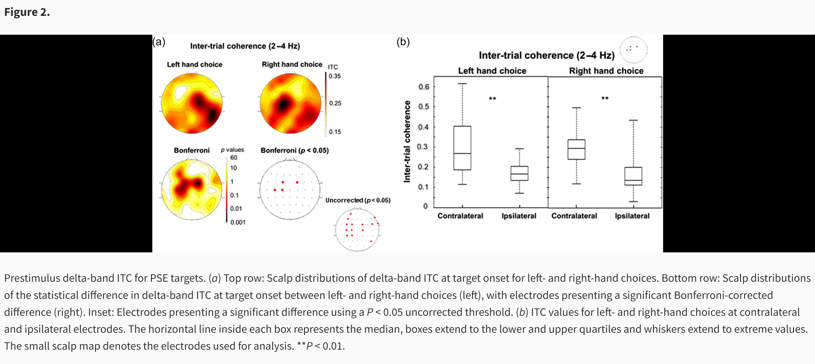
ITC for delta phase

Slide 3
The scalp plot for FDI is clearly wider and BCP narrower (which strongly meet the hypo)
The Contralateral and ipsilateral patten is inversed compared to MuBeta
(C3/C4 plot) It start at same level and have same saturation point
(C3/C4 plot) The slope for the High/ low or FDI/BCP is different, and the diff between Contralateral and ipsilateral is observes after evidence onsite.

Slide 4
High vs Low （AVG C34） Delta
Stimulate lock
Delta_SL_CR_HL.mat
Notes:
更明显？？

Slide 5
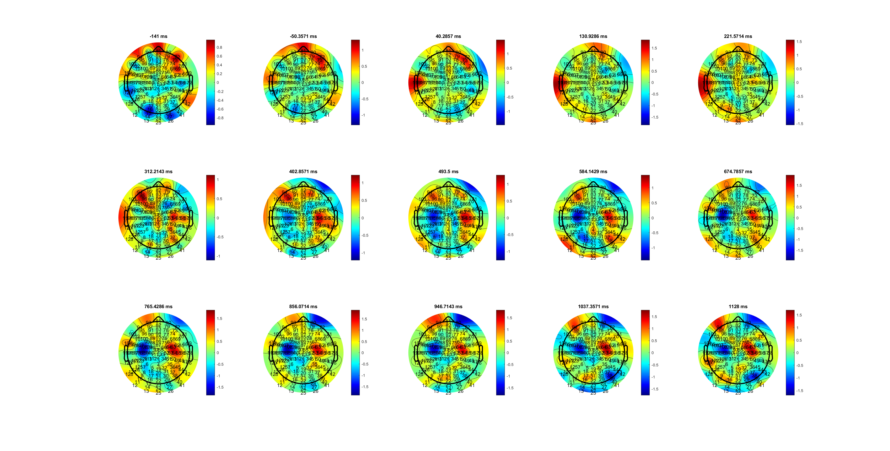
FDI (wider)
Stimulate lock
Delta_SL_CR_FDIBCP.mat

Slide 6
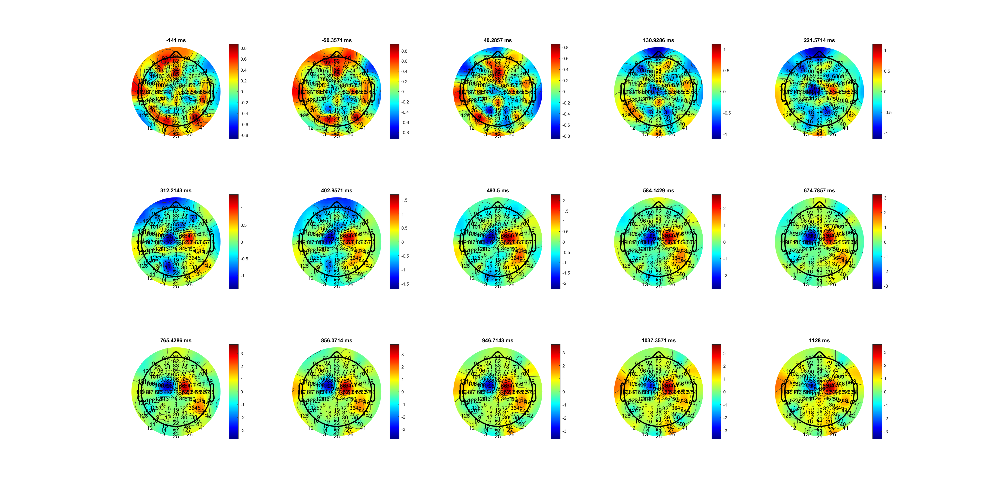
BCP (narrower)
Stimulate lock
Delta_SL_CR_FDIBCP.mat

Slide 7
AVG C34 Delta (average C34 because FDIBCP location diff)
Stimulate lock
Delta_SL_CR_FDIBCP.mat

Slide 8
High vs Low AVG C34
EMG onsite lock
Delta_EOL_HL.mat

Slide 9
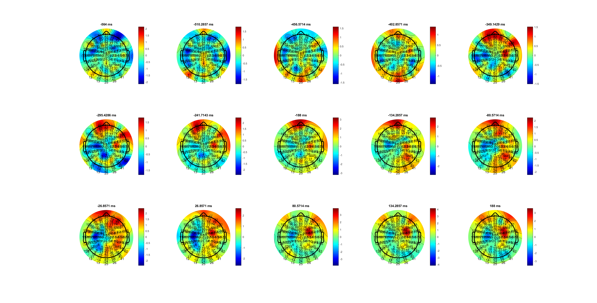
FDI
EMG onsite lock
Delta_EOL_FDIBCP.mat

Slide 10
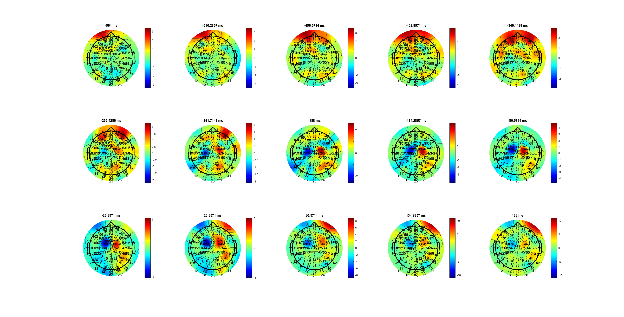
BCP
EMG onsite lock
Delta_EOL_FDIBCP.mat

Slide 11
AVG C34
EMG onsite lock
Delta_EOL_FDIBCP.mat

